Slide 1
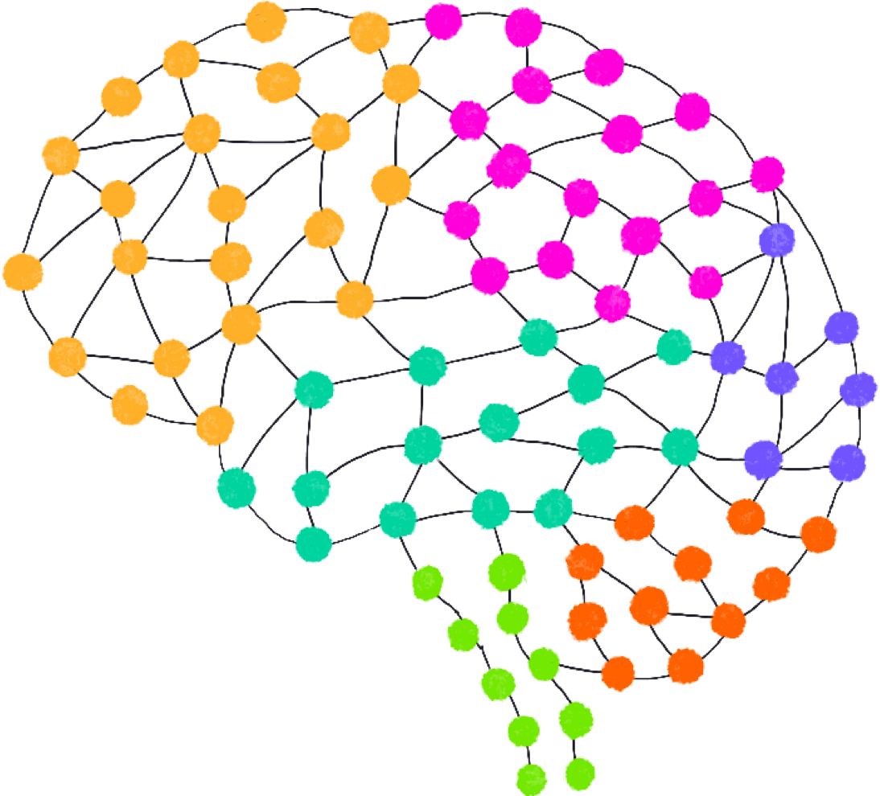
Symboisis Skills and Professional University(SSPU) Certificate course in Data Associate
Brain Tumor Detection
Project :--
Batch No. :-- D-16
Guided by:-- Mrs.Ashwini Gurav
Presented by :--
komal rajesh sharma
Chaitali rajendrasingh Jadhav
Yogeshwari ganesh sawant

Slide 2

Project introduction
Brain Tumor is one of the most dangerous diseases which require early and accurately detection methods.
Now most detection and diagnosis method depend on decision of neurospecialists, and radiologist for image evaluation which is possible to human errors and time consuming.
The main purpose of this project is to build a robust CNN model that can classify if the subject has a tumor or not based on Brain MRI scan images with an acceptable accuracy for medical grade application.

Slide 3
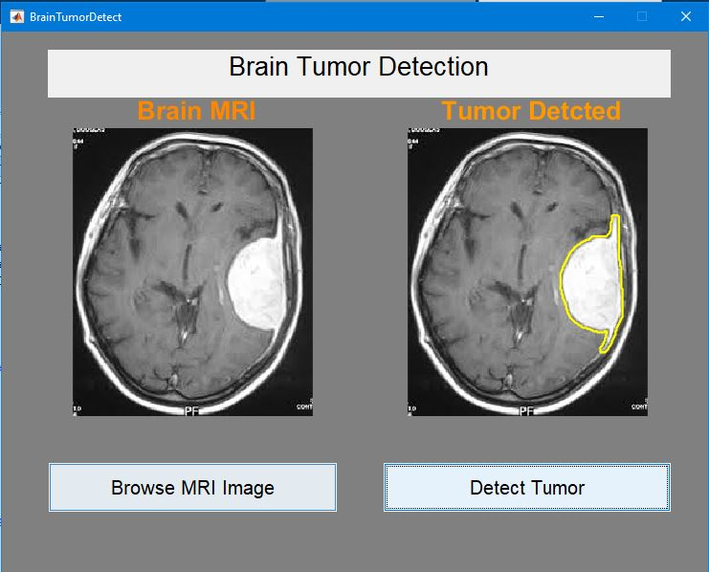
Libraries
import numpy as np
import pandas as pd
import seaborn as sns
import matplotlib.pyplot as plt
from sklearn.preprocessing import Standardscaler
from sklearn.model_selection import train_test_split

Slide 4
Datasets and tools
Dataset :-- https://www.kaggle.com
Tools used :--
Python
Numpy :-- Used for Numeric Calculation
Pandas :-- Used for Data Analysis
Matplotlib :-- Used for Data Visualization
Seaborn :-- Used for Data Visualization
Sklearn :--Used for making Statistical Graphics

Slide 5
Feature scaling
Feature Scaling is a technique to standardize the independent features present in the data in a fixed range.
It is performed during the data pre-processing to handle highly varying magnitudes or values or units.
Feature scaling is a vital pre processing step in machine learning that involves transforming numerical features to a common scale.

Slide 6
algorithms
Logistic Regression Classfication :-- Logistic regression is classification algorithm used to estimate discrete values, typically binary, such as 0 and 1, yes or no.
Decision Tree Classification :-- Decision Trees are versatile and simple classification and regression techniques.
Random Forest Classfication :-- Random forest are an ensemble learning techniques that combines multiple decision trees to improve prective accuracy and control over-fitting.
Support Vector Classfication(SVC) :-- SVM is an effective classification and regression algorithm. It seeks the hyperplane that best classifies data whileincreasing the margin. SVM works well in high-dimensional areas and handles nonlinear feature interactions with its kernel technique. It is powerful classification algorithm known for their accuracy in high-dimensional spaces

Slide 7
ADVantages and disadvantages of brain tumor
Disadvantages:
Symptoms and Complications: Brain tumors can cause various symptoms, such as difficulty speaking, vision changes, weakness, and numbness. Although benign tumors exist, they can still exert pressure on nerves and brain tissue, leading to serious complications and even death.
Advantages:
Early Detection: Some brain tumors cause noticeable symptoms, leading to early detection and timely treatment.
Research Opportunities: Brain tumor research provides insights into brain function and potential therapeutic strategies
Malignancy: Malignant brain tumors (glioblastomas) grow quickly and invade brain tissue, posing serious health risks
Complications: Even benign tumors can lead to complications if they grow and exert pressure on nerves or brain structures

Slide 8
Confusion matrix
A confusion matrix is a tool used in machine learning to evaluate the performance of a classification model. It is a table that compares the actual outcomes with the predicted outcomes of the model.
True Positive (TP) :-- The model correctly predicts a positive class.
True Negative (TN ) :-- The model correctly predicts a negative class.
False Positive (FP) :-- The model incorrectly predicts a positive class (Type I error).
False Negative (FN) :-- The model incorrectly predicts a negative class (Type II error).
The confusion matrix helps in understanding the types of errors made by the model and provides insights into its accuracy, precision, recall, and overall performance.
.

Slide 9
results
Now,the best model (the one with the best validation accuracy) detects brain tumor with:
98% accuracy on the test set.
98% f1 score on the test set.
These results are very good considering that the data is balanced.
Performance table of the best model:
 | Validation set | Test set
Accuracy | 98% | 98%
F1 score | 91% | 98%

Slide 10
Goal
The goal of this project is to generate a large dataset that includes genomic, clinical, molecular, and patient-reported information that can be shared with the biomedical community in order to accelerate discoveries and better therapies for this disease.
Cancer is not a single disease, and each medical record, tumor, and patient's story holds part of the puzzle.
Our goal is to help the research community better understand the landscape of brain tumors and accelerate discoveries by making data more readily available.

Slide 11
reference
Visited the website :--
Kaggle :-- https://www.kaggle.com
Github :-- https://github.com

Slide 12
THANK YOU !!!

